Slide 1
System and Cyber Security
L. Budi Handoko, M.Kom. (handoko@dosen.dinus.ac.id /
handoko@dsn.dinus.ac.id)
Dian Nuswantoro University

Slide 2
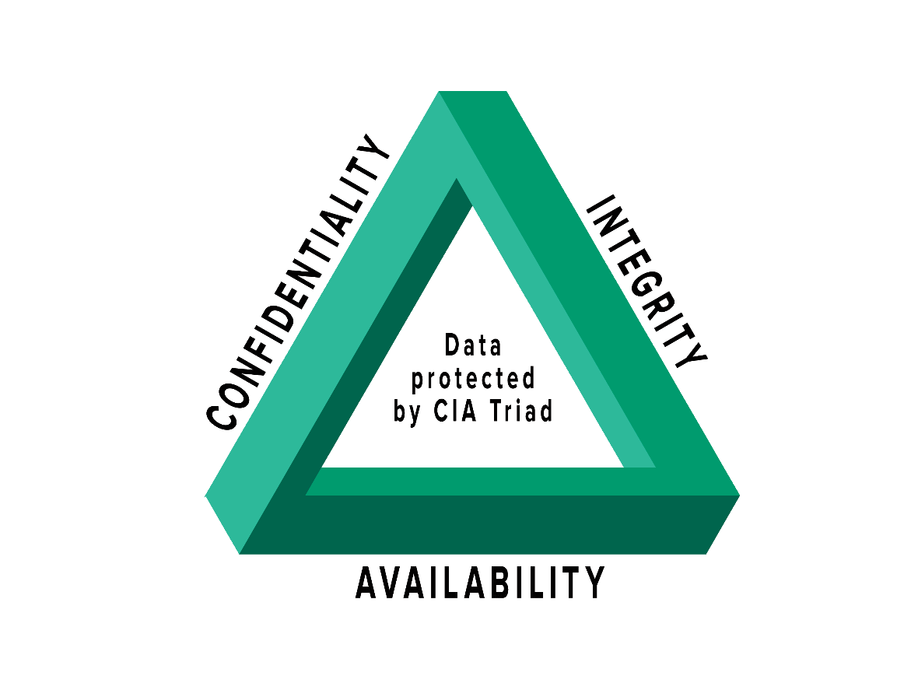
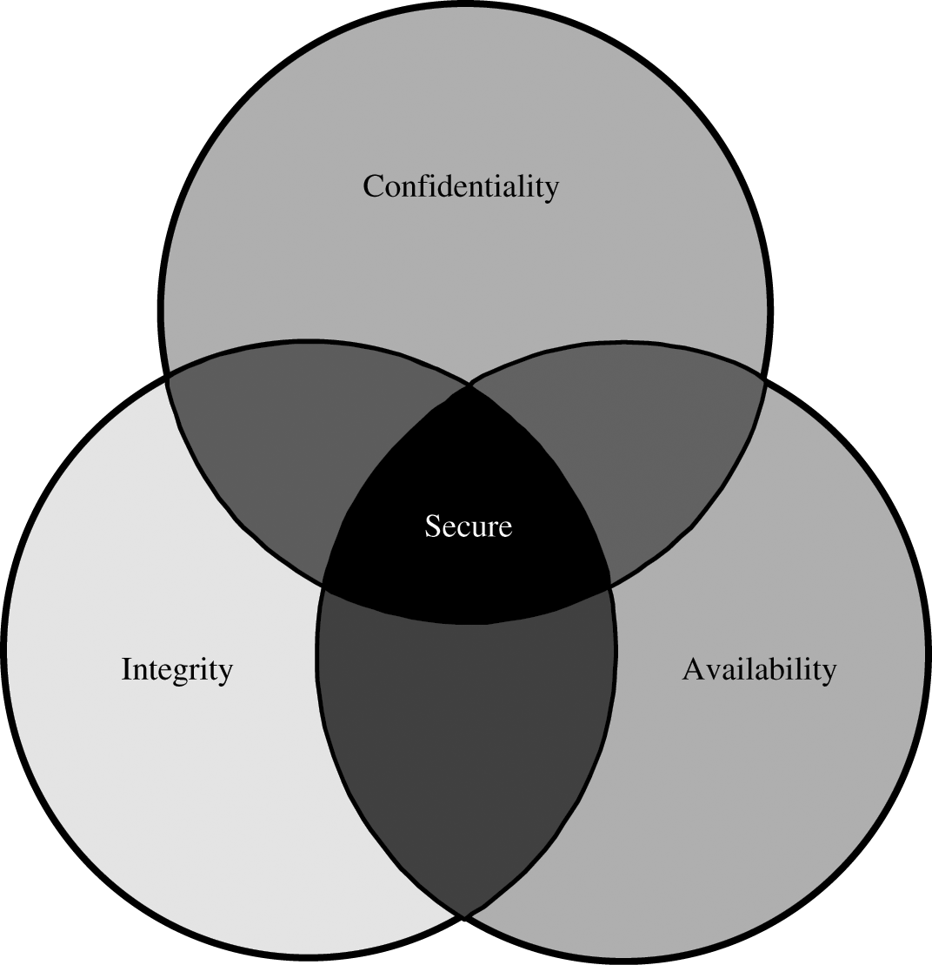
Triad CIA – Security Aspect

Slide 3
Proteksi dari
Akses tidak sah
Penggunaan tidak sah
Pemberitahuan rahasia
Confidentiality (Kerahasiaan)
Proteksi untuk pencegahan penggunaan tanpa ijin terhadap sebuah informasi yang bersifat penting atau rahasia.
Integrity (Integritas)
Deteksi terhadap terjaganya akurasi dan dan lengkapnya sebuah informasi.
Availability (Ketersediaan)
Kontrol terhadap pengguna yang benar-benar berhak sah dan tepat untuk mendapatkan informasi secara tepat waktu.
Proteksi data
Dalam sistem
Dalam perjalanan
Dalam proses
Deteksi perubahan yang terjadi
Dalam penyimpanan
Dalam perjalanan
Dalam proses
Kontrol memastikan
Akses sah
Performa yang dapat diterima
Toleransi kesalahan
Redundansi
Backup yang reliabel
Penghindaran kehilangan atau kehancuran data

Slide 4
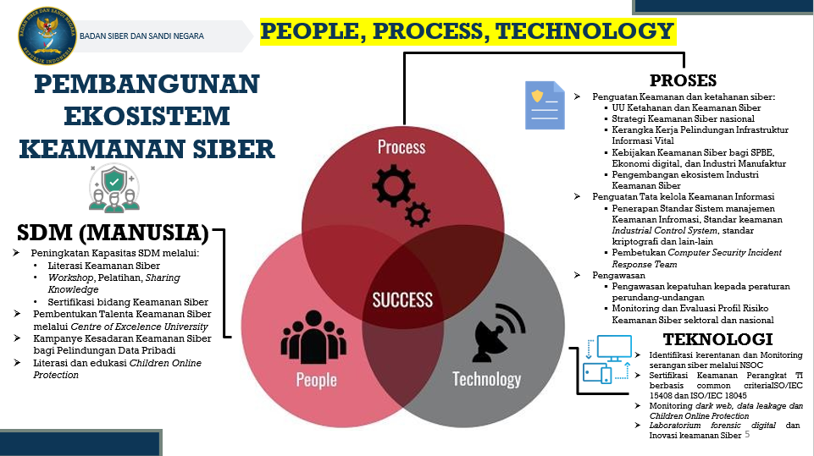

Slide 5
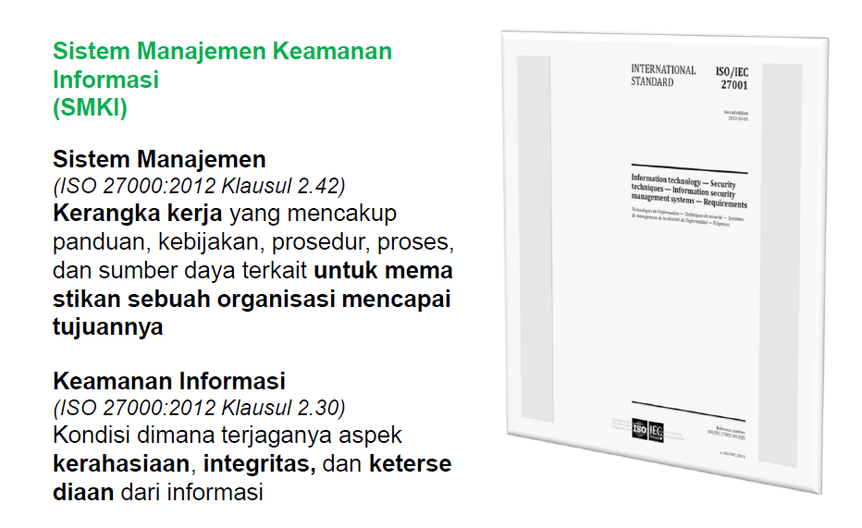

Slide 6
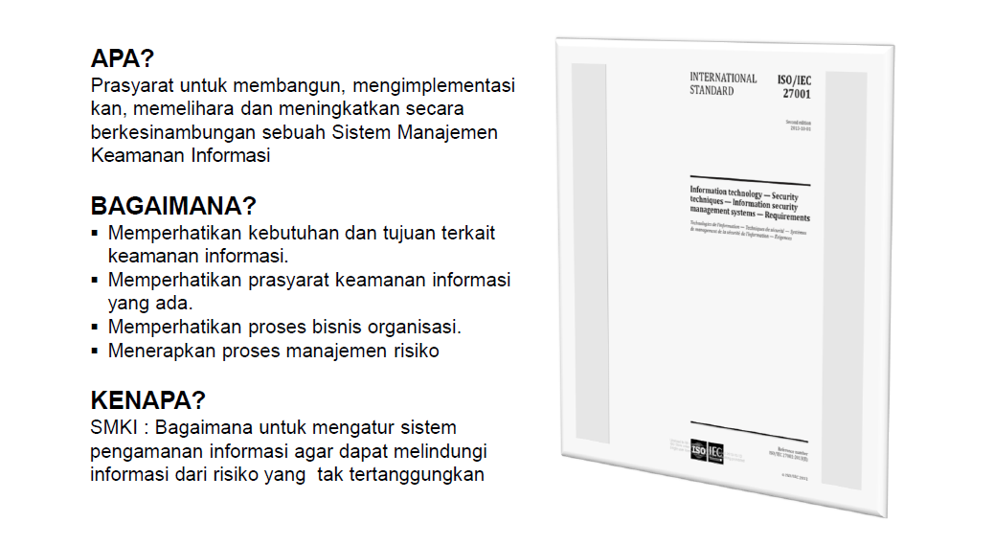

Slide 7
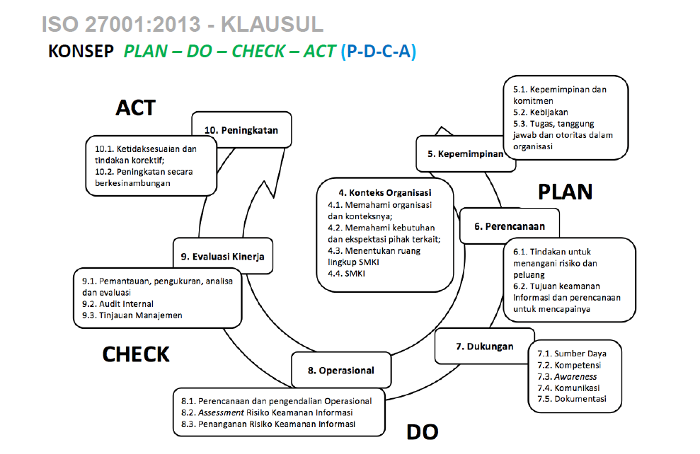

Slide 8

Any Question ?
Anything to discuss ?

Slide 9
Security Attacks
Interruption: This is an attack on availability
Interception: This is an attack on confidentiality
Modification: This is an attack on integrity
Fabrication: This is an attack on authenticity

Slide 10
Illustration Type Of Attacks/Threats
Information
Information
source
(a) Normal Flow
Destination
I
I
(b) Interruption
(d) Fabrication
I
I
(c) Modification
(e) Interception

Slide 11
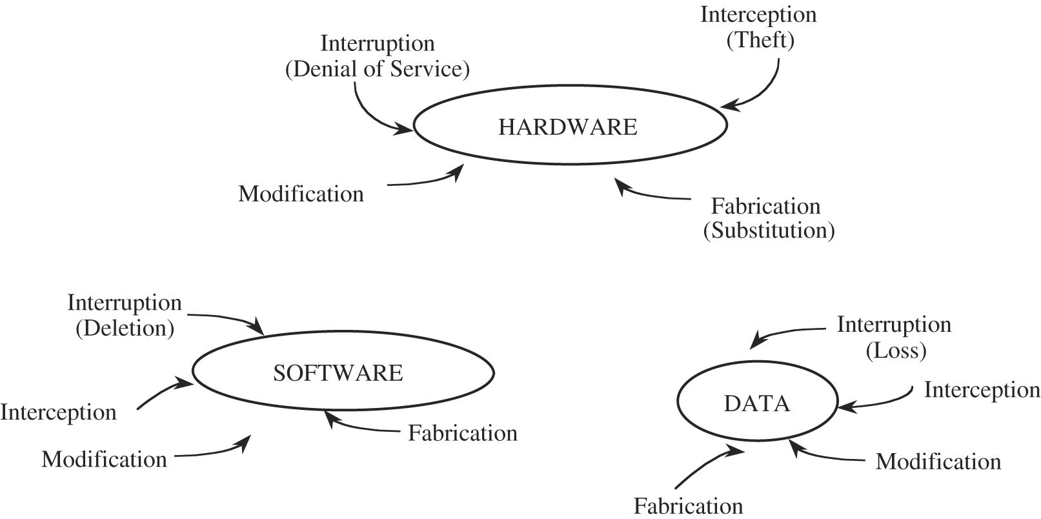

Slide 12
Active and Passive Attacks
Attack/threats
Passive threats
Active threats
Interception
Interruption Modification Fabrication
(Availability) (Integrity) (authentication)
Release of message Traffic analysis
contents

Slide 13
Active / Passive Attacks
A Passive attack can only observe communications or data. Example: Interception ( also called eavesdropping or passive wiretapping)
An Active attack can actively modify communications or data
• Often difficult to perform, but very powerful
– Mail forgery/modification
– TCP session hijacking /IP spoofing
Examples: Interruption, Modification ( also called active wiretapping), Fabrication
Types of Active Attacks: masquerade, replay, modification and denial of service.

Slide 14
Security Measure Levels
Impossible to have absolute security, but make cost to perpetrator sufficiently high to deter most intruders
Security must occur at four levels to be effective:
Physical
Data centers, servers, connected terminals
Human
Avoid social engineering, phishing, dumpster diving -> doxxing
Operating System
Protection mechanisms, debugging
Network
Intercepted communications, interruption, DOS
Security is as weak as the weakest link in the chain
But can too much security be a problem?

Slide 15
The Security Problem
System secure if resources used and accessed as intended under all circumstances
Unachievable
Intruders (crackers) attempt to breach security
Threat is potential security violation
Vulnerability is a weakness that can be exploited
Software bugs
Design flaws
Misconfiguration
Lack of encryption
Attack is attempt to breach security
Attack can be accidental or malicious
Easier to protect against accidental than malicious misuse

Slide 16
Computer security challenges
Virus
Email Virus
Worm
Trojan Horse
Spam
Ransome Ware
Keylogger
RedLine Stealer
Botnet
Rootkit
Spyware
Adware
Bloatware
etc.
Malicious Software
(MALWARE)

Slide 17
Common security attacks and their countermeasures
Finding a way into the network
Firewalls
Exploiting software bugs, buffer overflows
Intrusion Detection Systems
Denial of Service
Ingress filtering, IDS
TCP hijacking
IPSec
Packet sniffing
Encryption (SSH, SSL, HTTPS)
Social problems
Education

Slide 18
More Threats …
Many variations, many names
Trap Door
Specific user identifier or password that circumvents normal security procedures
Could be included in a compiler
How to detect them?
Logic Bomb
Program that initiates a security incident under certain circumstances
Stack and Buffer Overflow
Exploits a bug in a program (overflow either the stack or memory buffers)
Failure to check bounds on inputs, arguments
Write past arguments on the stack into the return address on stack
When routine returns from call, returns to hacked address
Pointed to code loaded onto stack that executes malicious code
Unauthorized user or privilege escalation

Slide 19
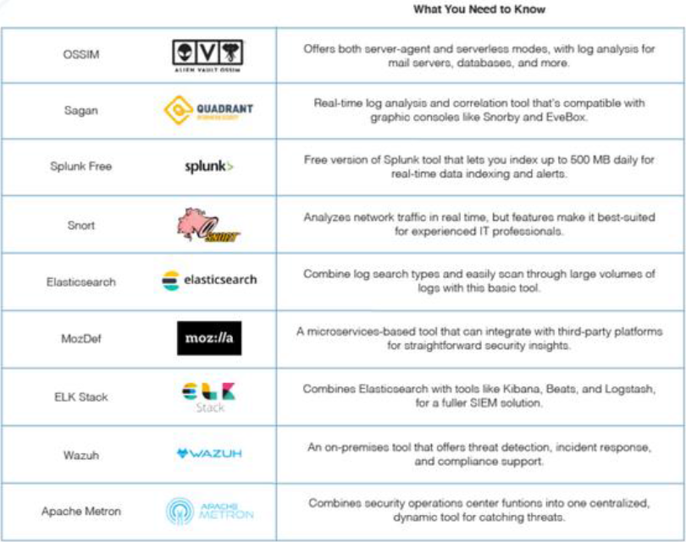
Free Security information and event management (SIEM) tools (Open-source)

Slide 20
Any Question ?
Anything to discuss ?

Slide 21


